Slide 1
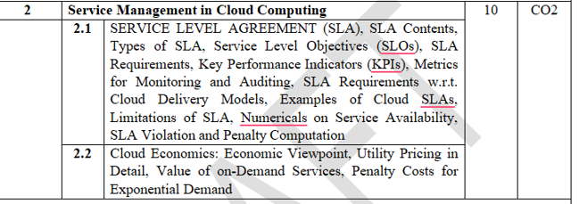
Module 2: Service Management in Cloud computing

Slide 2
Cloud Economics: Economic viewpoint
Introduction
Cloud Economics is the study of the financial benefits, costs, and business value of adopting cloud computing.
It helps organizations determine whether moving to the cloud is economically beneficial compared to maintaining traditional on-premises IT infrastructure.
The economic viewpoint focuses on minimizing costs, maximizing return on investment (ROI), improving resource utilization, and achieving business agility.

Slide 3
Cloud Economics: Economic viewpoint
Why Cloud Economics?
Organizations spend significant amounts on:
Purchasing servers
Networking equipment
Storage devices
Software licenses
Data centers
Cooling systems
Electricity
IT staff salaries
Maintenance contracts
Cloud computing reduces many of these expenses.

Slide 4
Cloud Economics: Economic viewpoint
Example:Traditional Data Center
A company wants to launch a new website.
It purchases:
10 servers
Storage devices
Networking equipment
UPS
Cooling systems
Initial investment: ₹50 Lakhs
Even if only 20% of the servers are used, the company has already paid the full cost.

Slide 5
Cloud Economics: Economic viewpoint
Cloud Solution:
Instead of purchasing hardware, the company rents virtual machines from AWS, Azure, or Google Cloud.
Cost: ₹50,000 per month
Advantages:
No upfront investment
Easy scaling
Lower maintenance costs
Pay only for what is used

Slide 6
Cloud Economics: Economic viewpoint
Objectives of Cloud Economics:
Reduce IT infrastructure costs.
Convert Capital Expenditure (CapEx) into Operational Expenditure (OpEx).
Improve resource utilization.
Increase business agility and scalability.
Reduce operational complexity.
Optimize IT spending.

Slide 7
Cloud Economics: Economic viewpoint
Objectives of Cloud Economics:
1. Reduce IT Infrastructure Costs
One of the primary objectives of cloud economics is to lower the total cost of acquiring, operating, and maintaining IT infrastructure.
How cloud helps:
Eliminates the need to purchase expensive servers, storage devices, and networking equipment.
Reduces spending on data centers, cooling systems, power supply, and physical space.

Slide 8
Cloud Economics: Economic viewpoint
Objectives of Cloud Economics:
1. Reduce IT Infrastructure Costs
How cloud helps:
Shifts maintenance responsibilities to the cloud provider.
Allows organizations to pay only for the resources they actually use.

Slide 9
Cloud Economics: Economic viewpoint
Objectives of Cloud Economics:
1. Reduce IT Infrastructure Costs
Example:
A company that previously spent ₹50 lakh on servers and data center facilities may instead rent virtual machines and storage from a cloud provider at a much lower annual cost.
Benefits:
Lower upfront investment.
Reduced maintenance expenses.
Lower electricity and cooling costs.
Better cost predictability.

Slide 10
Cloud Economics: Economic viewpoint
Objectives of Cloud Economics:
2. Convert Capital Expenditure (CapEx) into Operational Expenditure (OpEx)
Meaning:
Cloud economics encourages organizations to move from large upfront purchases (CapEx) to pay-as-you-go operational spending (OpEx).

Slide 11
Cloud Economics: Economic viewpoint
Objectives of Cloud Economics:
2. Convert Capital Expenditure (CapEx) into Operational Expenditure (OpEx)
CapEx:
Buying servers and storage.
Building data centers.
Purchasing networking hardware.
Large initial investment.
Assets depreciate over time.
OpEx:
Monthly cloud subscriptions.
VM usage charges.
Storage usage fees.
No large upfront investment.
Expenses are spread over time.

Slide 12
Cloud Economics: Economic viewpoint
Objectives of Cloud Economics:
2. Convert Capital Expenditure (CapEx) into Operational Expenditure (OpEx)
Why this is important:
Preserves cash flow.
Reduces financial risk.
Makes budgeting easier.
Allows businesses to invest capital in core activities instead of hardware.
Example:
Instead of spending ₹1 crore to build a data center, a company may pay ₹5 lakh per month for cloud services.
Economic impact:
The organization gains flexibility because expenses can increase or decrease according to demand.

Slide 13
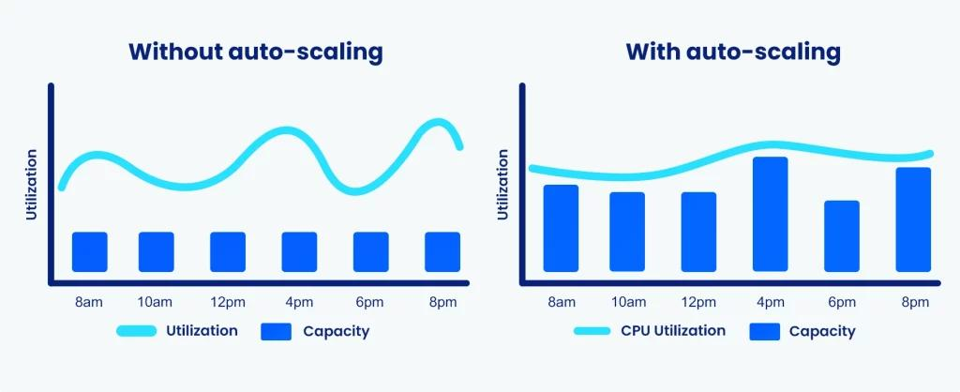
Cloud Economics: Economic viewpoint
Objectives of Cloud Economics:
3. Improve Resource Utilization
Meaning:
Traditional data centers often have underutilized servers. Many servers run at only 10–20% capacity, wasting money and energy.

Slide 14
Cloud Economics: Economic viewpoint
Objectives of Cloud Economics:
3. Improve Resource Utilization
Cloud objective:
Increase the percentage of computing resources that are actually used.
How cloud achieves this:
Virtualization allows multiple workloads to share the same physical hardware.
Resources can be allocated dynamically.
Unused resources can be released immediately.
Auto-scaling adjusts capacity based on workload.
Example:
A web application may need 50 servers during a sale but only 5 servers during normal operation. Cloud platforms automatically scale resources up and down.

Slide 15
Cloud Economics: Economic viewpoint
Objectives of Cloud Economics:
3. Improve Resource Utilization
Benefits:
Less wasted capacity.
Lower cost per transaction.
Higher efficiency.
Better return on IT assets.

Slide 16
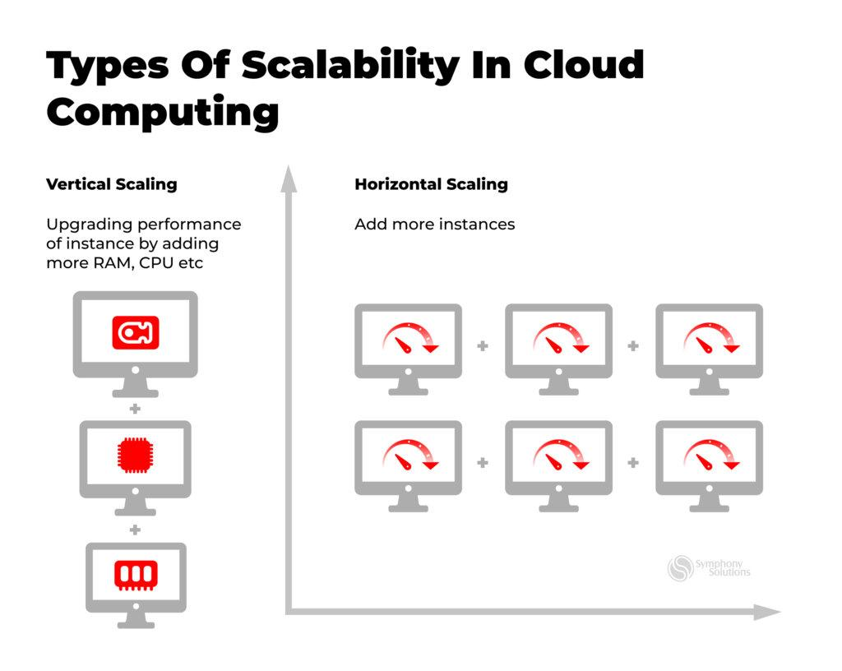
Cloud Economics: Economic viewpoint
4. Increase Business Agility and Scalability
Meaning:
Agility is the ability to respond quickly to business needs.
Scalability is the ability to increase or decrease resources as demand changes.

Slide 17
Cloud Economics: Economic viewpoint
4. Increase Business Agility and Scalability
Traditional IT:
Ordering hardware may take weeks or months.
Capacity planning is difficult.
Overprovisioning is common.
Cloud IT:
New servers can be deployed in minutes.
Storage can be expanded instantly.
Applications can scale automatically.
Global deployment becomes easier.
Example:
A startup launching a new mobile app can rapidly scale from 1,000 users to 1 million users without purchasing new hardware.

Slide 18
Cloud Economics: Economic viewpoint
4. Increase Business Agility and Scalability
Benefits:
Faster time-to-market.
Improved customer experience.
Ability to handle sudden demand spikes.
Support for business growth.

Slide 19
Cloud Economics: Economic viewpoint
5. Reduce Operational Complexity
Managing physical infrastructure is complex and requires specialized staff.
Traditional operations include:
Hardware installation.
Firmware updates.
Disk replacement.
Network configuration.
Backup management.
Disaster recovery planning.
Cloud objective:
Shift much of this operational burden to the cloud provider.

Slide 20
Cloud Economics: Economic viewpoint
5. Reduce Operational Complexity
Cloud providers handle:
Data center management.
Hardware maintenance.
Power and cooling.
Infrastructure monitoring.
Many security and compliance tasks.
Benefits:
Smaller operations teams.
Reduced administrative effort.
Fewer configuration errors.
Higher reliability.
IT staff can focus on business innovation rather than infrastructure maintenance.

Slide 21
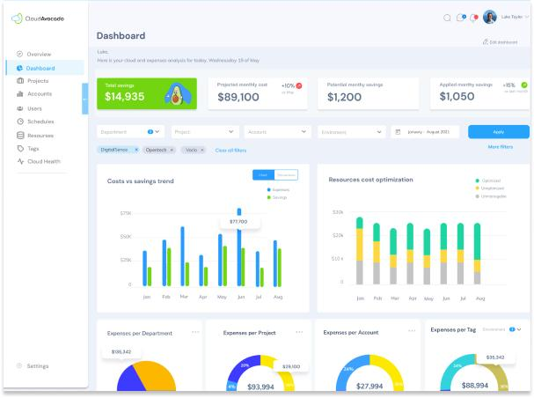
Cloud Economics: Economic viewpoint
6. Optimize IT Spending
The goal is not simply to spend less, but to spend IT money more efficiently.

Slide 22
Cloud Economics: Economic viewpoint
6. Optimize IT Spending
Cloud economics focuses on:
Right-sizing virtual machines.
Using reserved instances for predictable workloads.
Using spot/preemptible instances for non-critical tasks.
Removing idle resources.
Monitoring and analyzing usage continuously.
Automating cost governance.
Example:
A company discovers that 30% of its virtual machines are idle at night. By automatically shutting them down, it significantly reduces monthly cloud bills.

Slide 23
Cloud Economics: Economic viewpoint
6. Optimize IT Spending
Benefits:
Better budget control.
Higher ROI.
Lower waste.
Improved financial accountability.
Alignment of IT spending with business value.

Slide 24
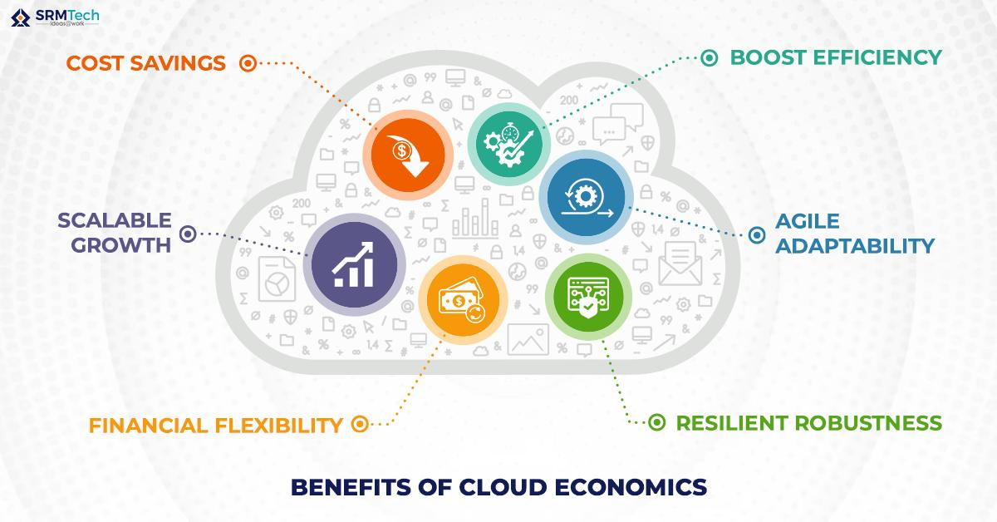
Cloud Economics: Economic viewpoint
6. Optimize IT Spending
Benefits:
Better budget control.
Higher ROI.
Lower waste.
Improved financial accountability.
Alignment of IT spending with business value.

Slide 25
Cloud Economics: Economic viewpoint
How these objectives work together:
Reduce infrastructure costs lowers overall IT expenditure.
Convert CapEx to OpEx improves cash flow and financial flexibility.
Improve resource utilization ensures infrastructure is not wasted.
Increase agility and scalability helps businesses respond quickly to market changes.
Reduce operational complexity frees IT teams from routine maintenance.
Optimize IT spending ensures every rupee spent delivers business value.

Slide 26
Cloud Economics: Economic viewpoint
The economic viewpoint evaluates whether cloud adoption creates financial value.
It considers:
Cost savings
Revenue growth
Business flexibility
Risk reduction
Productivity improvement

Slide 27
Cloud Economics: Economic viewpoint
Factors Considered
Initial Investment
Traditional: Very high
Cloud: Almost zero
2. Maintenance Cost
Traditional:
Hardware repairs
Software updates
Cooling
Power
Cloud: Managed by provider.

Slide 28
Cloud Economics: Economic viewpoint
Factors Considered
3. Scalability
Traditional: Need to purchase additional hardware.
Cloud: Increase resources within minutes.
4. Resource Utilization
Traditional: Servers remain idle.
Cloud: Resources allocated dynamically.
5. Risk
Cloud providers offer:
Disaster recovery
Backup
High availability
Reducing business risks.

Slide 29
Utility pricing in detail
Utility Pricing is a pricing model in cloud computing where customers pay only for the resources they actually consume, similar to how they pay for electricity, water, or gas. Instead of purchasing expensive IT infrastructure, users rent computing resources and are billed based on actual usage.
This model is also known as the Pay-As-You-Go (PAYG) or usage-based pricing model.
Utility Pricing is a cloud service pricing model in which customers are charged according to the amount of computing resources they use, such as CPU time, storage, bandwidth, or memory.
Definition:
Utility pricing is a consumption-based pricing model where customers pay only for the cloud resources they use, eliminating the need for large upfront investments.

Slide 30
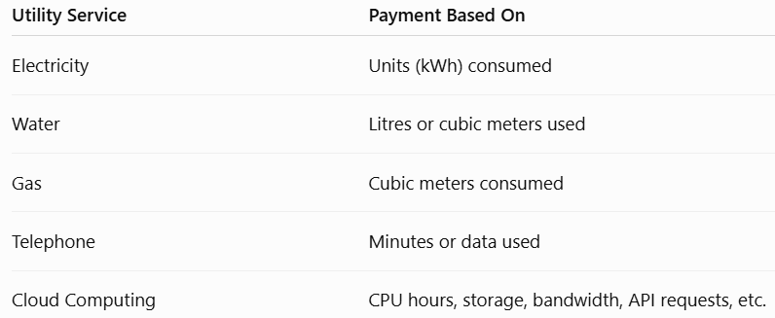
Utility pricing in detail
Why is it Called Utility Pricing?
Cloud computing follows the same concept as public utilities.
Just as you receive a monthly electricity bill based on usage, cloud providers generate bills based on the cloud resources consumed.

Slide 31
Utility pricing in detail
How Utility Pricing Works
The process is as follows:
User requests cloud resources (e.g., a virtual machine, storage, or database).
Cloud provider allocates the requested resources.
Usage is continuously monitored (CPU hours, storage, bandwidth, etc.).
Billing is calculated based on the pricing rates for the consumed resources.
Customer pays only for actual usage.

Slide 32
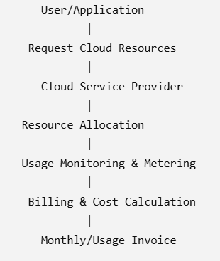
Utility pricing in detail
Utility Pricing Architecture

Slide 33
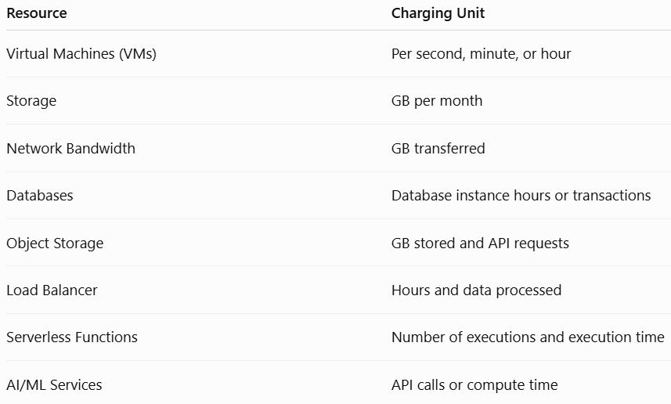
Utility pricing in detail
Resources Charged Under Utility Pricing
Cloud providers may charge for different resources, including:

Slide 34
Utility pricing in detail
Characteristics of Utility Pricing
1. Pay-As-You-Go (PAYG)
Users pay only for the resources they actually use.
Example:
A VM costs ₹10 per hour.
Used for 5 hours → ₹50
Used for 20 hours → ₹200

Slide 35
Utility pricing in detail
Characteristics of Utility Pricing
2. No Upfront Investment
Organizations do not need to buy expensive servers or networking equipment.
Instead, they rent cloud resources as required.
3. Flexible Pricing
Customers can:
Increase resources when demand rises.
Decrease resources when demand falls.
Billing automatically adjusts based on usage.

Slide 36
Utility pricing in detail
Characteristics of Utility Pricing
4. Measured Service
Cloud providers continuously monitor resource consumption using metering systems.
Measured parameters include:
CPU utilization
Memory usage
Storage consumed
Network traffic
API requests

Slide 37
Utility pricing in detail
Characteristics of Utility Pricing
5. Elasticity
Cloud resources can automatically scale up or down based on workload.
Example:
During a festival sale, an online store increases from 10 to 100 virtual machines.
After the sale, it scales back to 10 VMs.
The company pays for the additional VMs only during the sale period.

Slide 38
Utility pricing in detail
Advantages of Utility Pricing
1. Cost Savings
Customers avoid purchasing expensive hardware and infrastructure.
Benefit: Lower IT costs.
2. Better Resource Utilization
Only the required resources are allocated.
Unused resources are released, reducing waste.

Slide 39
Utility pricing in detail
Advantages of Utility Pricing
3. Easy Scalability
Resources can be increased or decreased within minutes.
Benefit: Supports changing business demands.
4. Financial Flexibility
Organizations avoid large capital investments and instead pay predictable operational expenses.
5. Faster Deployment
Virtual machines, databases, and storage can be provisioned quickly.

Slide 40
Utility pricing in detail
Advantages of Utility Pricing
6. Suitable for Small Businesses and Startups
Startups can launch services without investing in costly infrastructure.
7. Supports Innovation
Businesses can experiment with new ideas without purchasing permanent hardware.

Slide 41
Utility pricing in detail
Disadvantages of Utility Pricing
1. Unpredictable Costs
If resource usage increases unexpectedly, monthly bills can become much higher than anticipated.
2. Continuous Monitoring Required
Organizations must regularly monitor usage to avoid unnecessary expenses.
3. Idle Resources Still Cost Money
If a VM remains running but is not doing useful work, charges continue until it is stopped or deleted.

Slide 42
Utility pricing in detail
Disadvantages of Utility Pricing
4. Data Transfer Charges
Moving data out of the cloud (egress) often incurs additional costs.
5. Vendor Dependency
Each cloud provider has its own pricing model, making comparisons and migrations more complex.

Slide 43
Utility pricing in detail
Real life example of Utility Pricing
Real-Life Example
Traditional Data Center
A company purchases:
20 servers
Storage systems
Networking equipment
UPS and cooling systems
Total Cost: ₹80 lakh
Even if the servers are used only 30% of the time, the company still bears the full cost.

Slide 44
Utility pricing in detail
Real life example of Utility Pricing
Cloud Utility Pricing
The company rents:
20 virtual machines
2 TB of storage
500 GB of network bandwidth
If demand drops, it reduces to:
10 virtual machines
1 TB of storage
The monthly bill decreases automatically because payment is based on actual usage.

Slide 45
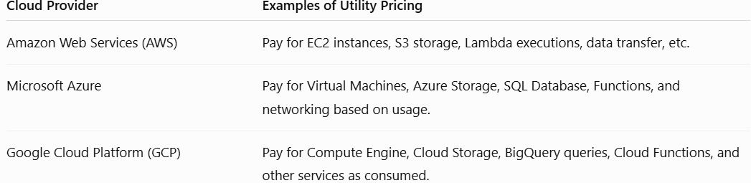
Utility pricing in detail
Utility Pricing in Major Cloud Platforms:

Slide 46
Value of on demand services
Value of On-Demand Services refers to the economic and business benefits organizations receive by using cloud computing resources only when they are needed.
Instead of purchasing and maintaining expensive IT infrastructure, organizations can instantly access computing resources such as servers, storage, databases, networking, and software over the internet and pay only for what they use.
On-demand service is a cloud computing characteristic where users can automatically provision and release computing resources whenever required, without human interaction from the cloud provider.
For example, if an e-commerce website experiences a sudden increase in traffic during a festival sale, it can instantly obtain additional servers from the cloud and release them after the sale end

Slide 47
Value of on demand services
Advantages:
1. Cost Savings
Organizations avoid purchasing costly hardware, software, and networking equipment.
Traditional IT
Buy servers in advance.
Pay for installation and maintenance.
Hardware remains underutilized during normal periods.
On-Demand Cloud
Rent resources only when required.
No upfront investment.
Lower operational costs.

Slide 48
Value of on demand services
Advantages:
1. Cost Savings
Example:
A startup launches a website using cloud servers instead of buying ₹15 lakh worth of hardware.
Benefit
Lower Capital Expenditure (CapEx)
Reduced maintenance costs

Slide 49
Value of on demand services
Advantages:
2. Pay-as-You-Go Pricing
Users pay only for the resources they consume.
Examples:
Per hour of virtual machine usage
Per GB of storage
Per database request
Per API call
Example : A company uses:
100 GB storage
20 computing hours
It pays only for these resources rather than purchasing permanent infrastructure.

Slide 50
Value of on demand services
Advantages:
2. Pay-as-You-Go Pricing
Users pay only for the resources they consume.
Examples:
Per hour of virtual machine usage
Per GB of storage
Per database request
Per API call
Example :A company uses:
100 GB storage
20 computing hours
It pays only for these resources rather than purchasing permanent infrastructure.
Benefit: Eliminates unnecessary expenses.,Better budgeting.

Slide 51
Value of on demand services
Advantages:
3. Elastic Scalability
Resources can automatically increase or decrease depending on workload.
During High Demand:
Add more servers
Increase storage
Increase network bandwidth
During Low Demand:
Remove extra servers
Reduce storage
Lower costs

Slide 52
Value of on demand services
Advantages:
3. Elastic Scalability
Example
An online shopping website:
Uses 5 servers on normal days.
Expands to 50 servers during Diwali.
Returns to 5 servers after the sale.
Benefit
No over-provisioning
Better customer experience

Slide 53
Value of on demand services
Advantages:
4. Faster Time-to-Market
Cloud resources are available within minutes instead of weeks.
Traditional Approach:
Purchase hardware
Install operating systems
Configure networking
Test infrastructure
May take several weeks.
Cloud Approach:
Launch virtual machines immediately.
Begin application development instantly.
Benefit:Faster product launches,Increased business agility.

Slide 54
Value of on demand services
Advantages:
5. Improved Resource Utilization
Resources are allocated dynamically based on actual demand.
Instead of servers sitting idle:
CPU is shared.
Memory is allocated efficiently.
Storage expands only when needed.
Benefit
Higher utilization
Lower wastage

Slide 55
Value of on demand services
Advantages:
6. Business Agility
Organizations can quickly respond to changing business needs.
Examples:
Launch a new application.
Open a new regional service.
Support seasonal demand.
Test new ideas.
Benefit
Faster innovation
Competitive advantage

Slide 56
Value of on demand services
Advantages:
7. High Availability
Cloud providers distribute services across multiple data centers.
If one server fails:
Another server immediately handles requests.
Benefit
Minimal downtime
Better reliability

Slide 57
Value of on demand services
Advantages:
8. Global Accessibility
Services can be accessed from anywhere using the Internet.
Employees can:
Work from home.
Access applications remotely.
Collaborate globally.
Benefit
Increased productivity
Supports remote work

Slide 58
Value of on demand services
Advantages:
9. Reduced IT Management
Cloud providers handle:
Hardware maintenance
Software updates
Security patches
Backup
Disaster recovery
Organizations can focus on business instead of infrastructure.

Slide 59
Value of on demand services
Advantages:
10. Supports Innovation
Developers can quickly create testing environments.
Instead of waiting weeks:
Create a virtual machine in minutes.
Test software.
Delete resources after testing.
Benefit
Faster experimentation
Lower development costs

Slide 60
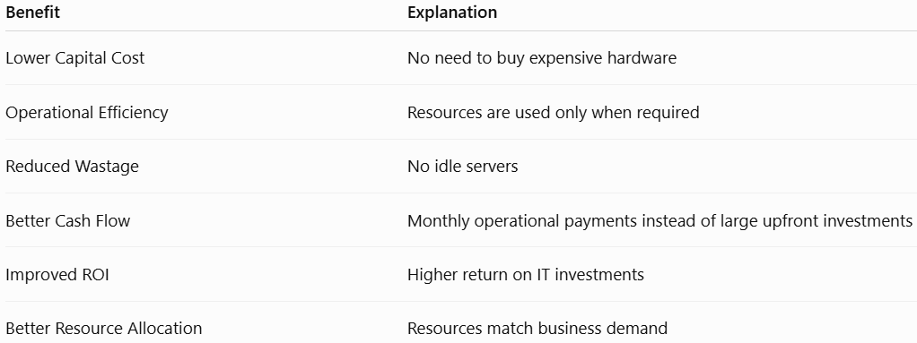
Value of on demand services
Economic Benefits

Slide 61
Value of on demand services
Real-Life Example
A video streaming company experiences increased traffic during the release of a popular movie.
Without On-Demand Services
Must purchase enough servers for peak demand.
Most servers remain idle after the event.
High capital investment.
With On-Demand Services
Rent additional cloud servers during the release.
Automatically scale down after traffic decreases.
Pay only for the extra resources used.
Result:Lower costs,Better performance,Efficient resource utilization

Slide 62
Value of on demand services
Advantages of On-Demand Services:
No upfront infrastructure investment.
Pay only for actual usage.
Instant provisioning of resources.
Automatic scaling up or down.
Reduced maintenance effort.
High availability and reliability.
Faster deployment of applications.
Better resource utilization.
Supports business growth.
Enables global access and collaboration.

Slide 63
Value of on demand services
If demand grows faster than resources can be provisioned, you may experience:
Increased latency
Request failures
Timeouts
Database throttling
Queue buildup
Service degradation
Higher costs
Potential outages
So cloud providers need capacity planning in addition to automatic scaling.

Slide 64
Value of on demand services
Limitations:
Costs can increase with excessive or unmanaged usage.
Dependence on a reliable internet connection.
Possible vendor lock-in when relying heavily on one cloud provider.
Data security and compliance concerns for sensitive workloads.
Performance may vary depending on network latency.
When cloud demand expands exponentially, the infrastructure must scale horizontally, distribute data and requests across many resources, replicate data for availability, and automatically scale up/down to maintain performance while controlling cost.

Slide 65
Penalty costs for Exponential demand
Penalty cost is the cost incurred when the available computing resources do not match the actual user demand.
In cloud computing, if demand grows exponentially, fixed or delayed resource provisioning cannot keep up, causing the penalty cost to increase rapidly.

Slide 66

Penalty costs for Exponential demand
Penalty Cost Formula
The penalty cost is proportional to the difference between demand and available resources over time:
Where:
D(t) = Demand at time t
R(t) = Resources available at time t
If demand and resources are equal, the penalty cost is zero.

Slide 67
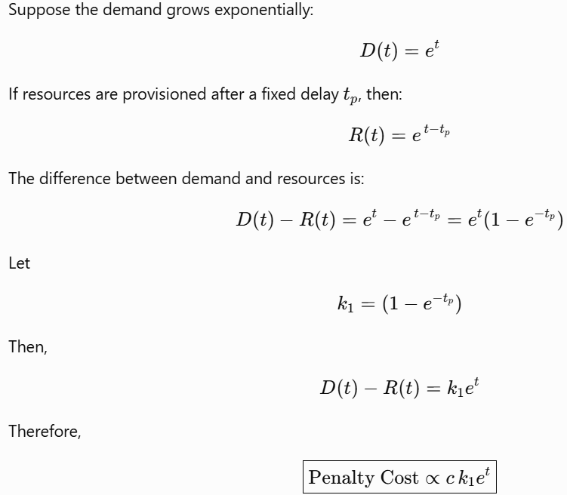
Penalty costs for Exponential demand
Exponential Demand

Slide 68

Penalty costs for Exponential demand
Exponential Demand
where:
c = Cost per unit shortage
k1= Constant depending on the provisioning delay
e^{t}= Exponential growth of demand
This shows that the penalty cost also grows exponentially as demand increases.

Slide 69
Penalty costs for Exponential demand
When demand increases very rapidly:
The cloud provider provisions resources based on current demand.
By the time new resources are available, demand has already grown much higher.
The gap between demand and available resources keeps increasing.
As a result, the penalty cost rises exponentially.
This situation is common during:
Viral social media events
Flash sales
Online ticket booking
Black Friday or festive shopping
Breaking news websites
Sudden spikes in streaming traffic

